Slide 1
Predicting Seattle City Accident Severity
By Ashutosh Tiwari

Slide 2
Predicting Seattle city is valuable for transport department
The Seattle is the coastal are hence it is very much crowded place and becomes very difficult for transport department to handle the crowd.
Sometime the accidents create lots of disturbance in the city.
More people lose there life's because the transport department acts on after the accident happens.
Predicting the accidents severity can inform the people of Seattle city to take precautions on specific areas and conditions.
Monitoring over different environmental scenarios becomes easy.

Slide 3
Data acquisition and cleaning
The Seattle data provided by the Seattle city transport department can be found Clicking here. And meta data Clicking here which contains the relevant information and descriptions for norms used in dataset.
This dataset contained the data from 2004 to 2020 for the incidents of Seattle city under different coordinates.
The column which did not had any relevance to our goal were also removed such as ["SEVERITYCODE.1","OBJECTID","INCKEY","COLDETKEY","REPORTNO","INTKEY","EXCEPTRSNCODE","EXCEPTRSNDESC","INATTENTIONIND","PEDROWNOTGRNT","SDOTCOLNUM","SEGLANEKEY","CROSSWALKKEY“
The total number of records we got are (184167, 25).

Slide 4
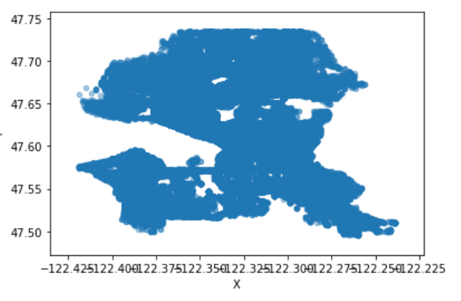
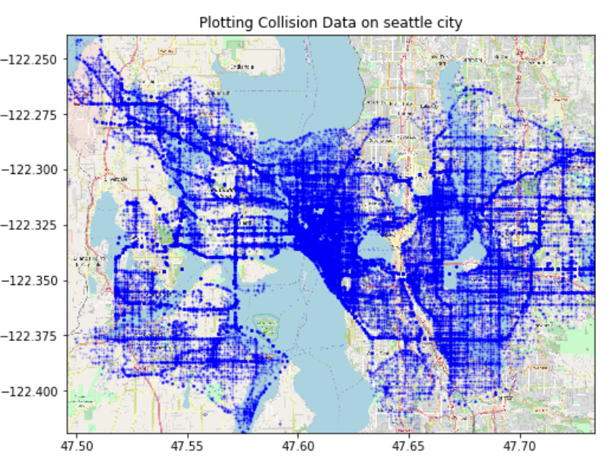
Occurrence of accidents Seattle city

Slide 5
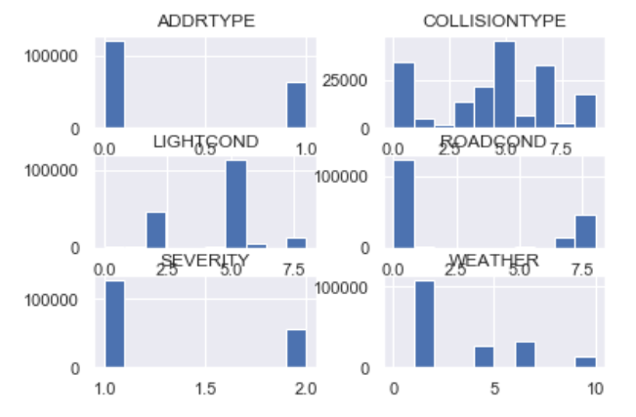
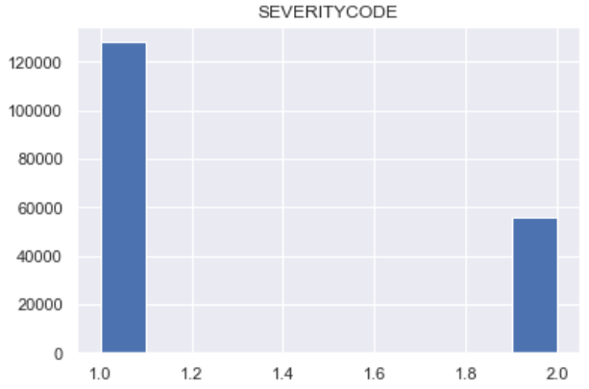
Comparison between severity and different attributes
As we can see the different attributes of the data can effect the severity of accident upon which the Collision, light and weather are most important.

Slide 6
Regression and Classification model
linear models (linear regression, Ridge regression, and Lasso regression), Logistic Regression to the dataset, using root mean squared error (RMSE) as the tuning and evaluation metric.
The predicted values had much narrow range than the actual values, and as a result, the prediction errors were larger as the actual values deviated further from zero.
Assign accidents to samples based on the inverse of the abundances of target values.
K nearest model had the best performance among all models, which had k=4 less error than the benchmark model.
Performance of the regression/classification models
 | Simple regression | Decision Tree | K nearest model | Logistic Regression
Accuracy | 0.42 | 0.724 | 0.726 | 0.688

Slide 7
Conclusion and Future directions
I identified road condition, lights, weather conditions ,collision type and mostly the location among the most important features that affect accident severity on road.
These models can be very useful in helping Seattle city transport department management in a number of ways. For example, it could help identify accidental prone areas, weather conditions warning to the people , road condition monitoring etc.
During project was able to achieve ~42% improvement from the benchmark model in the regression problem, and ~72% accuracy in the classification problem
We can utilize more data based on transportation, police department , hospitalization etc.

